Slide 1

Students of VIT CHENNAI
SAATVIK SUMANT
VISHAL CHOWDHARY
DILNAWAZ HOSSAIN ASRAFI
NEHAA SHRI.M.S

Slide 2
GEOMAGNETIC STORM
SOLAR WIND
Solar Wind is a constant stream of charged particles (mainly electrons and protons) flowing from the Sun's outer atmosphere (the corona).
Solar Wind is a result of the Sun's high temperature and the corona's expansion into space.
GEOMAGNETIC STORM
Geomagnetic Storms are sudden disturbances in Earth's magnetic field caused by interactions with Solar Wind.Geomagnetic storms are a result of interactions between the Solar Wind and Earth's magnetosphere, which is a protective magnetic field surrounding our planet.
INTERACTION
Solar Wind Composition
Approaching Earth
Magnetosphere Interaction
Magnetic Reconnection
Energy Transfer
Geomagnetic Storm Formation
Auroras and Effects

Slide 3
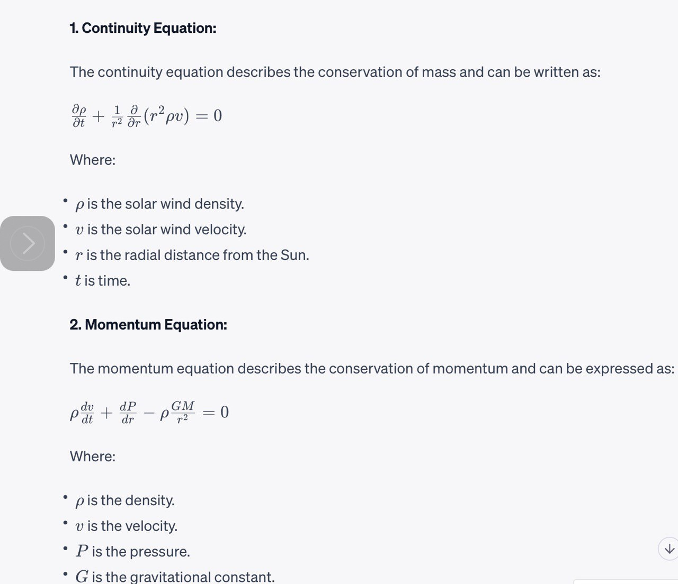
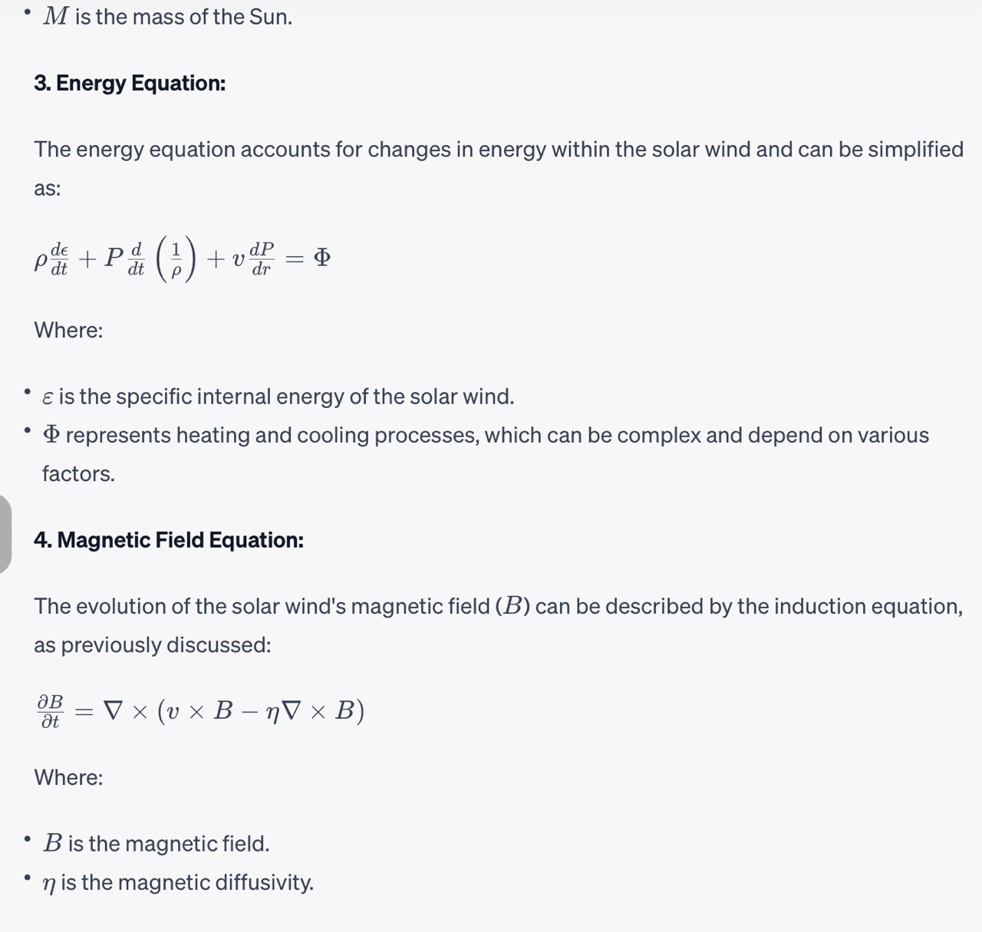
MAGNETOHYDRODYNAMIC EQUATIONS

Slide 4
GEOMAGNETIC INDICES
These indices are used for determining the intensity of the Geomagnetic storm that is going to form.
One such widely used index is the Kp index.There is no such empirical relation for determining the Kp index but we can give a proportionality relation for it,
Kp = a.Vmax + b.Bmax
Where Vmax and Bmax are the maximum value of the velocities and magnetic field strengths recorded in a given time frame, a and b are the weighting constants which can be determined by using the previous trends of the Kp indices recorded and applying a linear regression model to it.

Slide 5
LSTM MODEL IN USAGE
Using an LSTM (Long Short-Term Memory) model for predicting the intensity of solar storms on Earth based on KP index and other relevant features like proton speed, proton density, and magnetic intensity can be a suitable choice for several reasons:
1. Sequential Data Handling:
Solar storm data often exhibit temporal dependencies, where the current state of the solar storm is influenced by past values of the same and related parameters. LSTM models are well-suited for handling sequential data because they can capture long-term dependencies and remember information from previous time steps. This is crucial for modeling the dynamics of solar storms, as the intensity of a storm at a given time may be influenced by the conditions in previous time periods.
2. Variable-Length Sequences:
Solar storm data may not have a fixed number of time steps, and the time intervals between measurements can vary. LSTM models can handle variable-length sequences, making them flexible for working with irregularly sampled time series data. This is valuable when dealing with solar storm data, as observations may not occur at uniform intervals.
3. Feature Extraction and Representation Learning:
LSTMs are capable of learning and extracting complex patterns and representations from sequential data. By training an LSTM model on historical solar storm data, it can learn the relationships and patterns between the KP index, proton speed, proton density, and magnetic intensity, which may not be apparent through traditional statistical methods. This feature extraction capability can lead to more accurate predictions, especially when dealing with intricate and nonlinear relationships in the data.

Slide 6
WORKFLOW
1. Input Data (Raw Satellite Data): Raw data from the DSCOVR satellite, including proton speed, proton density, and magnetic intensity of solar storms, is used as input.
2.User Interface updation:Inputting parameters through the UI for the project
3..Data Preprocessing: Data preprocessing involves cleaning, transforming, and preparing the raw data for training and prediction. This step may include data normalization, splitting data into training and testing sets, and handling missing values.
4.*LSTM Model Training:The preprocessed data is used to train an LSTM machine learning model. This model learns to capture the relationships between the input features (proton speed, proton density, magnetic intensity) and the target variable (solar storm nature) based on historical data.
5..Predict Solar Storm Nature The trained LSTM model is used to make predictions for the nature of solar storms based on the input data. The model predicts the KP index or a related metric to determine the severity of the solar storm.
6.Display of Predicted Results in the UI

Slide 7
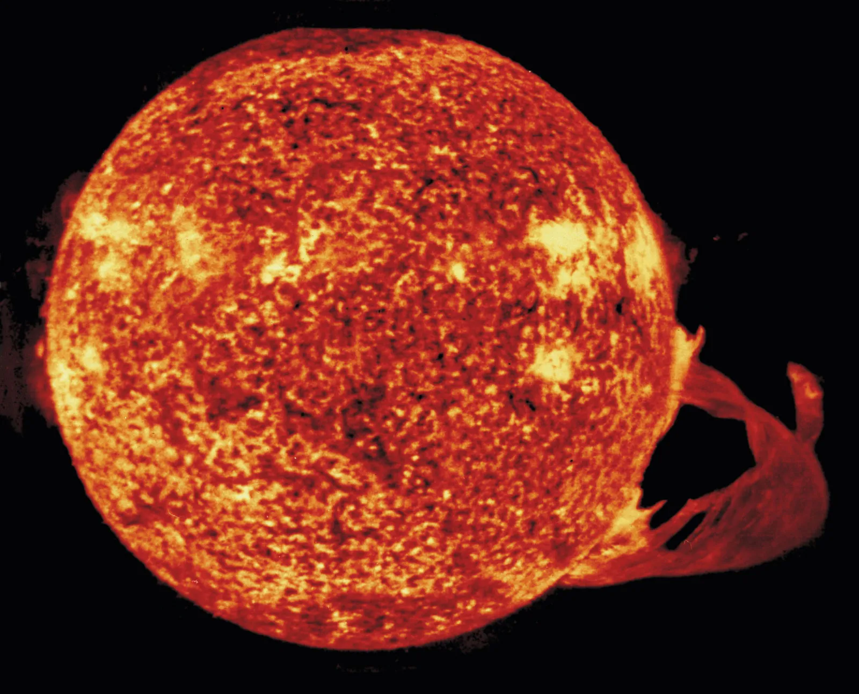
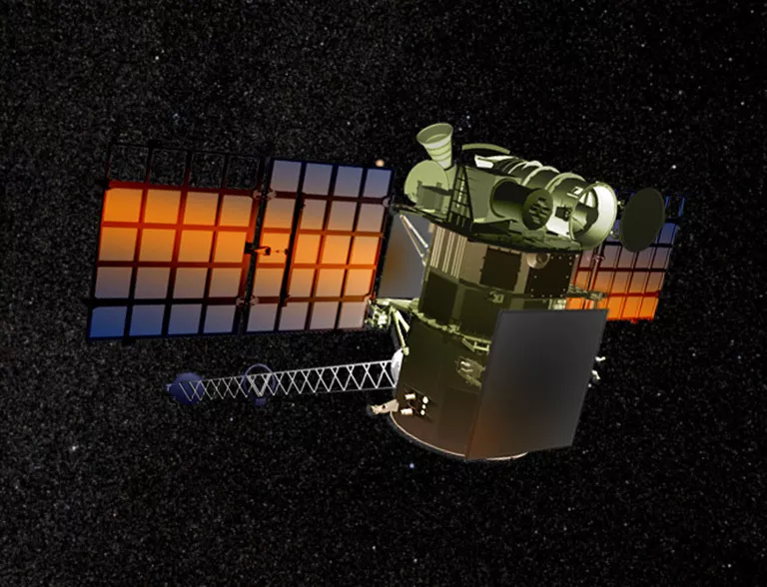
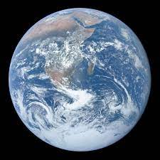
The raw data is then sent to the earth through DSCOVER satellite.The data is then sent to UI
Calculation of kp index and prediction of solar storm nature using Kp.Future predictions will be made by using LSTM model on the dataset.
Collection of raw data such as solar wind speed,plasma density,magentic strength

